Slide 1
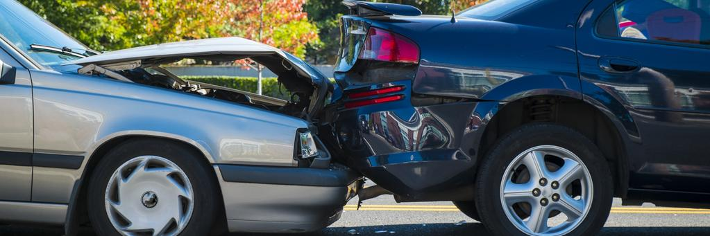
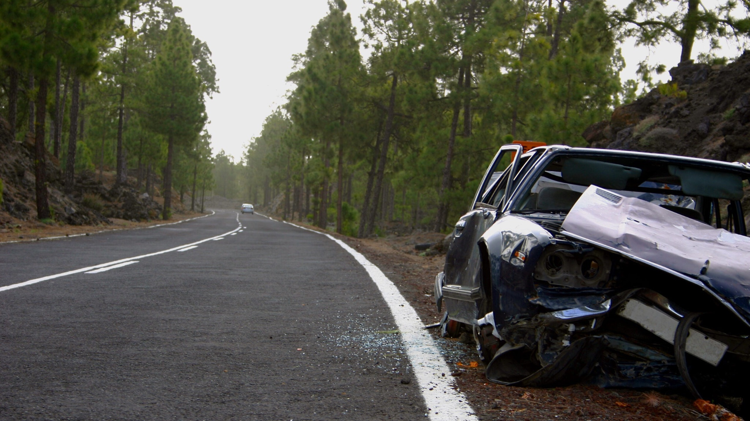
NSW Road Crashes
Data analysis on the factors leading to crashes and road fatalities in NSW

Slide 2
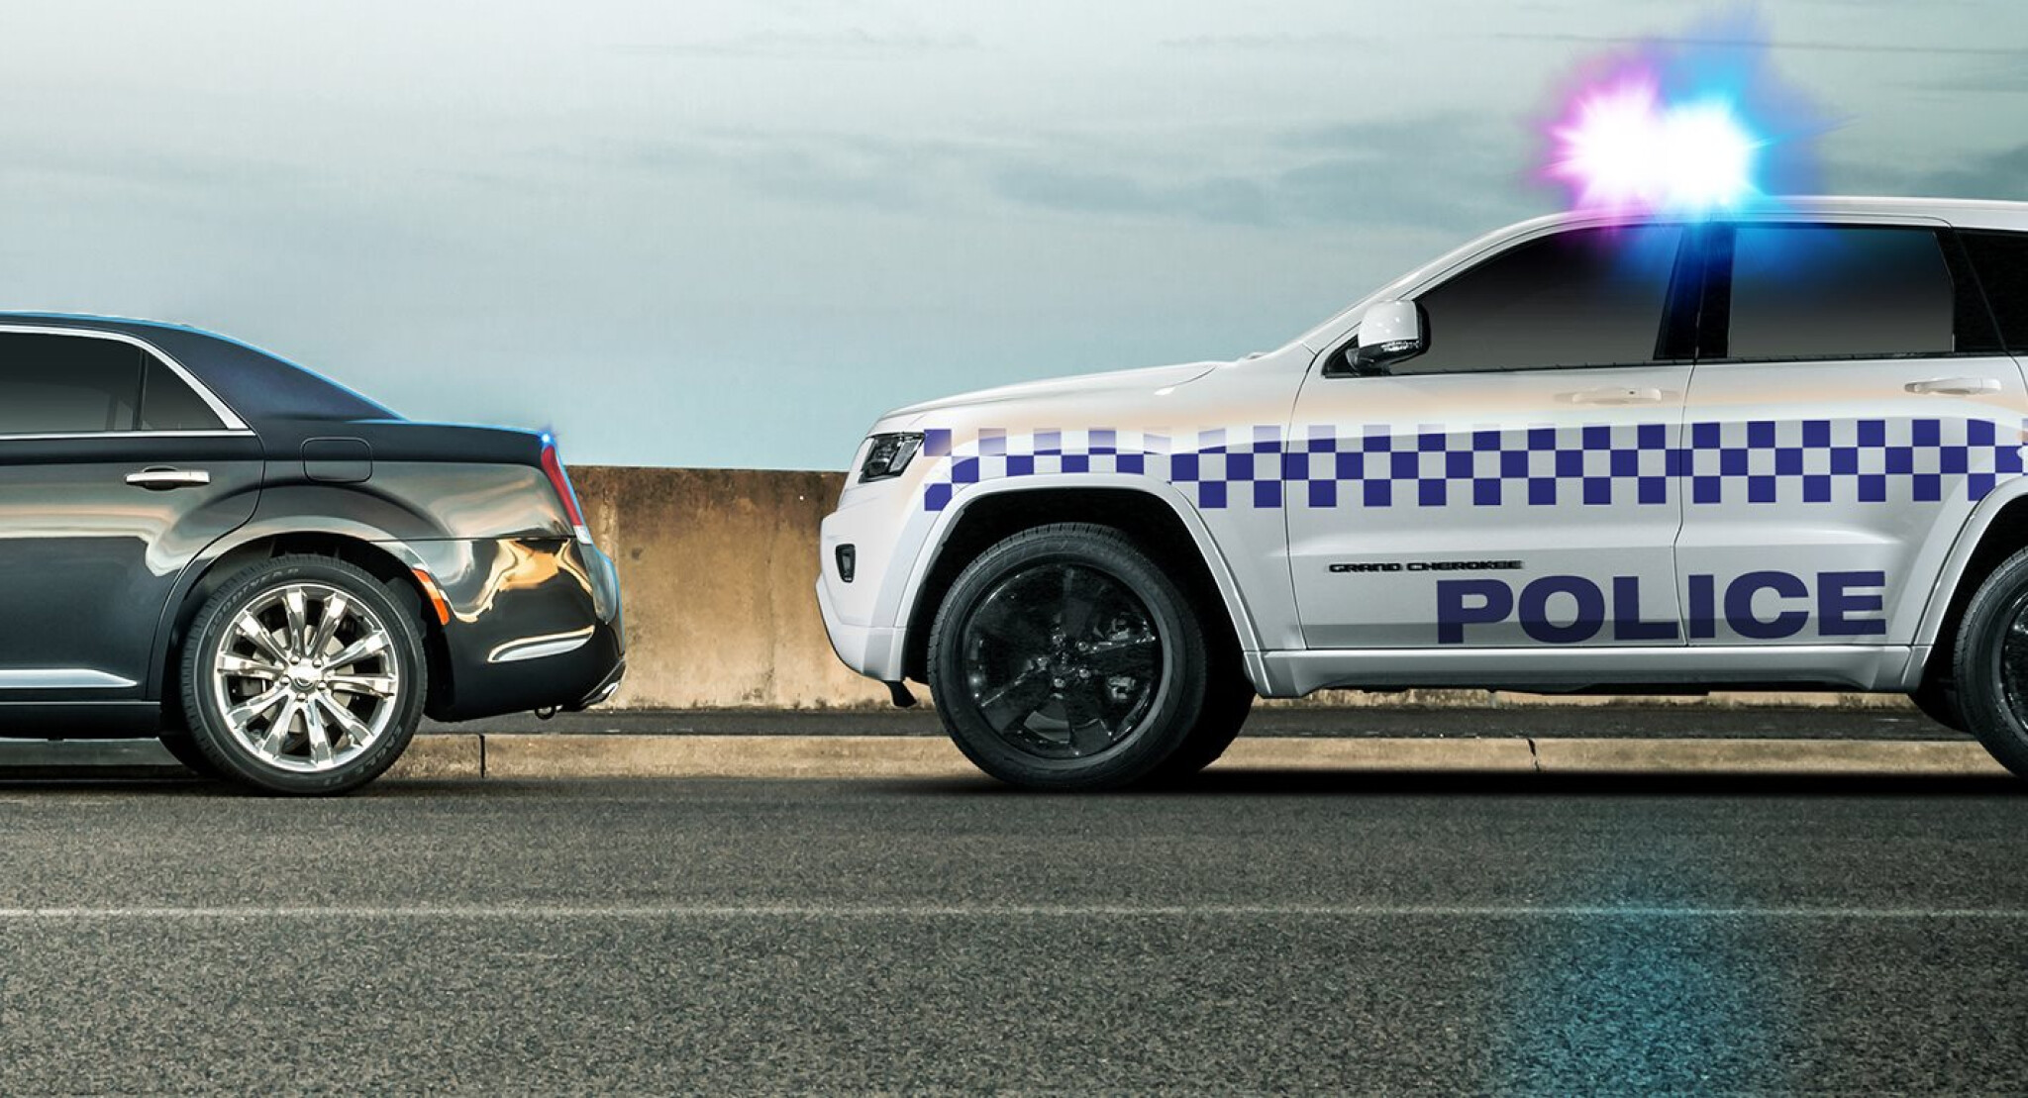
NSW Road Crash Analysis Contents
Overview on the aim to reduce crashes and fatalities.
Data showed many factors influenced road crashes
Impact of lighting / technology
Does unsealed roads lead to more crashes?
Effects by speed limit
Weather conditions and the affects
Certain times of day, month, year that need more attention

Slide 3
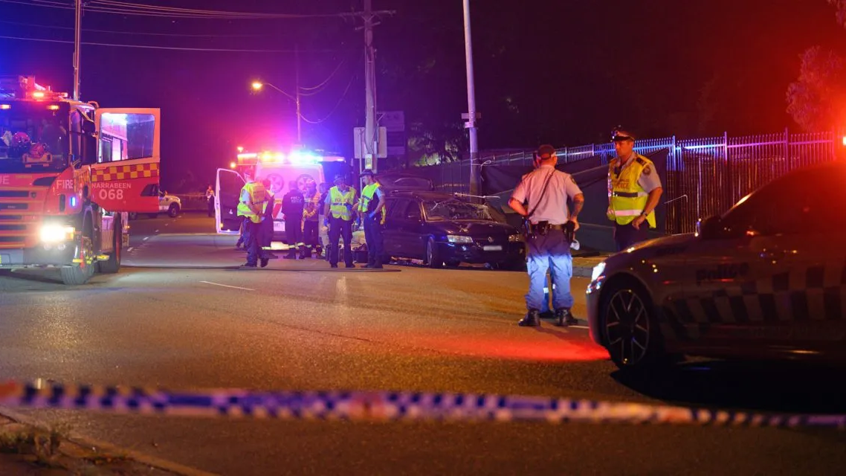
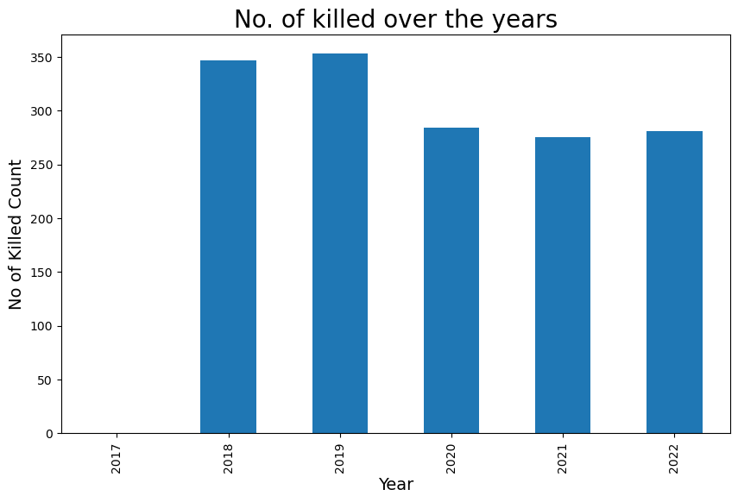
Number of people killed over the years
This graph shows that over the 5 years, there has been a constant decrease.
Significant decrease in 2020.

Slide 4
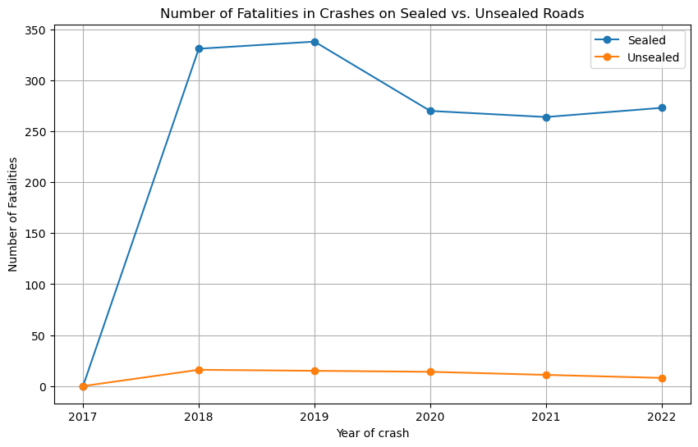
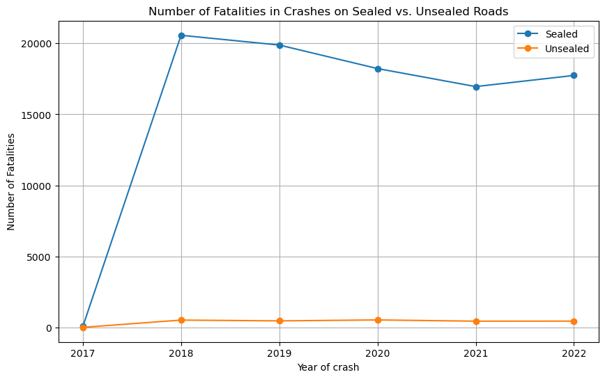
The effects of sealed roads and unsealed roads
Most crashes are on sealed roads
Unsealed roads shows a consistent number of crashes throughout the years
No significant correlation between the two types of roads

Slide 5
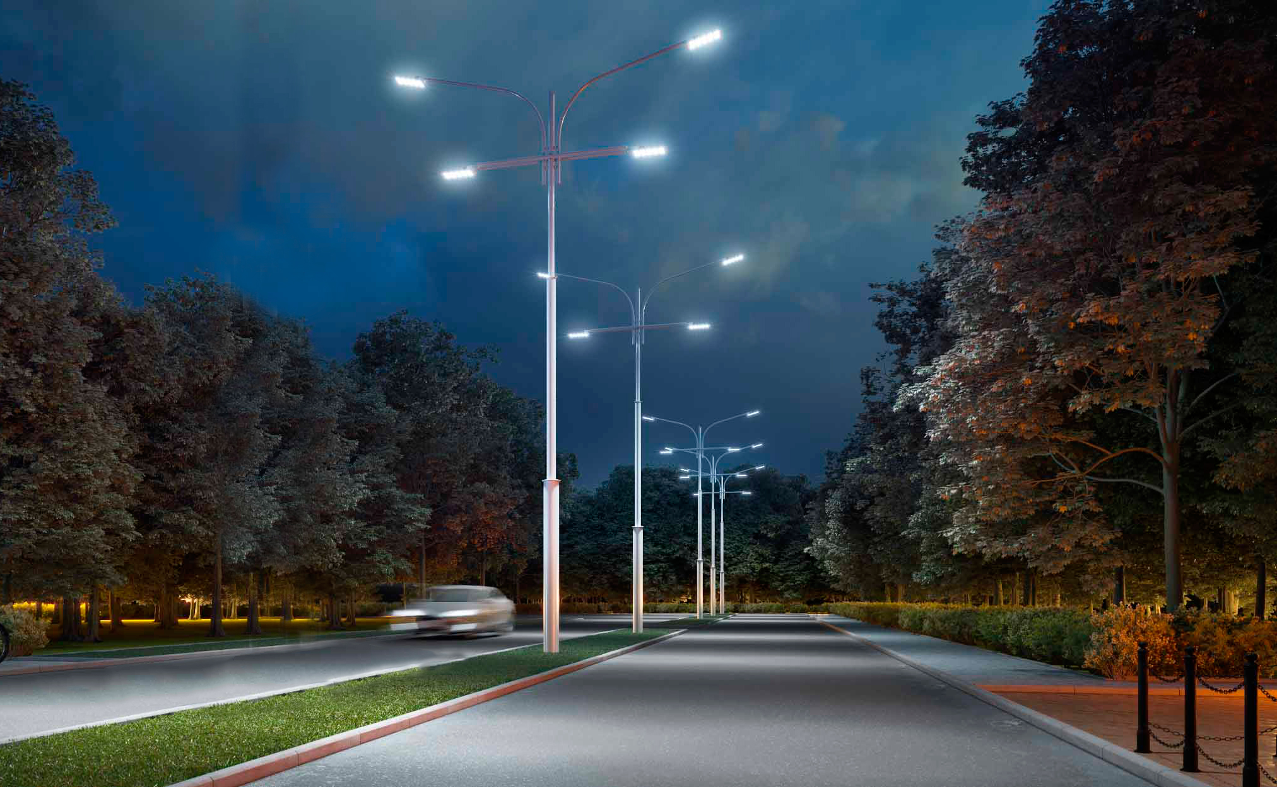
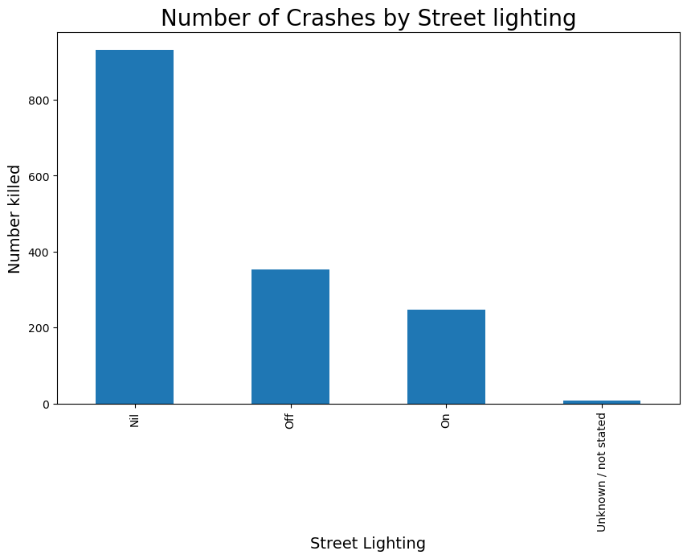
Effect on street lighting
Shows a strong correlation between street lighting and number of people killed.
Most deaths were occurred with no lighting at all.

Slide 6
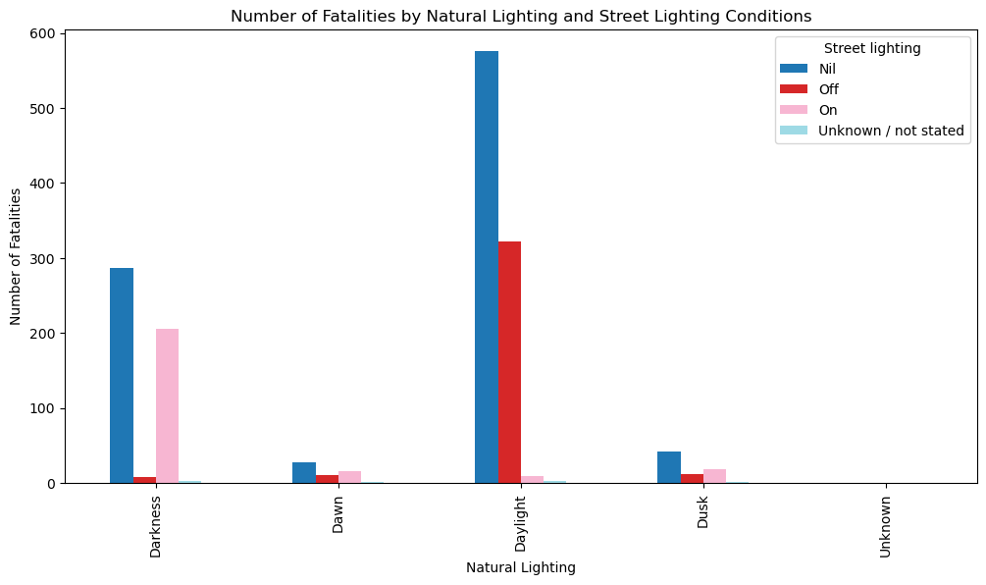
Natural and street lighting
Although most fatalities happened during the day, there is no extra light needed to prevent the crash.
However, as for fatalities during the dark approximately 300 fatalities had no light.

Slide 7
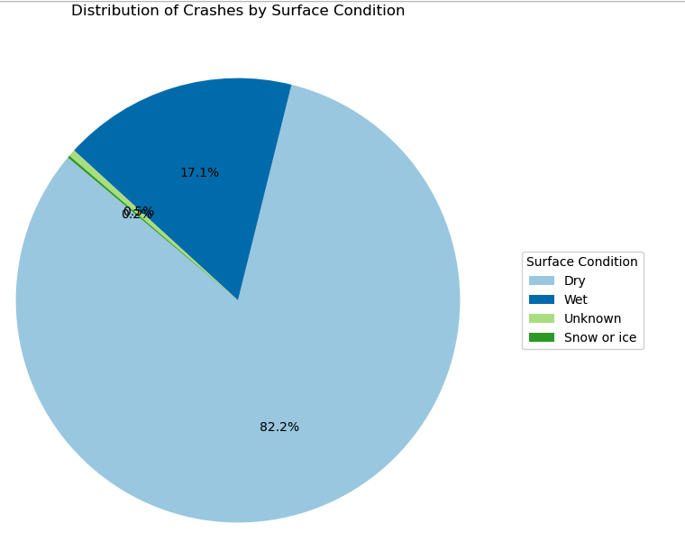
Distribution of crashes by surface condition
QUICK TIP
Try right clicking on a photo and using "Replace Image" to show your own photo.
Notes:
Describe the surface conditions that were looked into
Describe the hypothesis
Describe the actual results

Slide 8
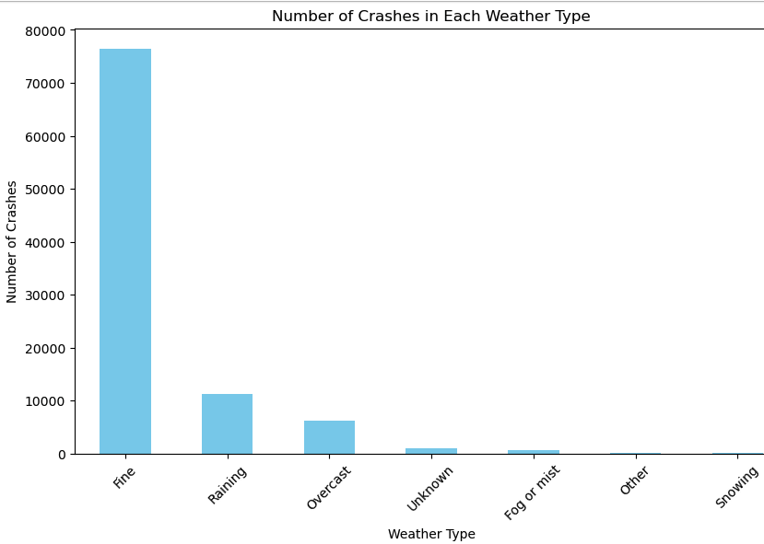
Analysis of Crashes by weather present
Notes:
Describe the weather conditions that were looked into
Describe the hypothesis
Describe the actual results

Slide 9
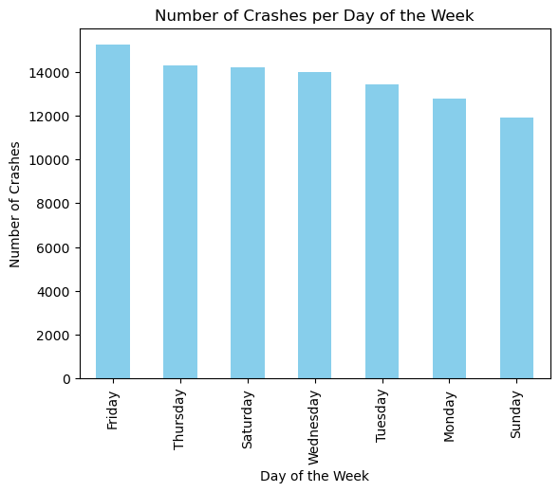
Not much variance between days.
Sunday has the least, most likely due to people being at home and relaxing.

Slide 10
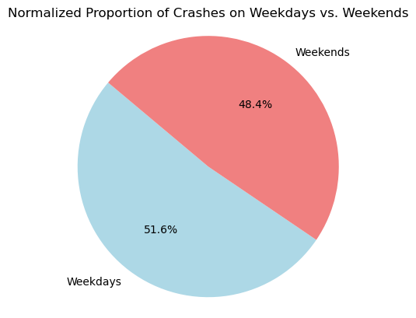
When apportioning the weekend’s 2 days to match the weekdays 5 days, you can see it is almost a perfect split.

Slide 11
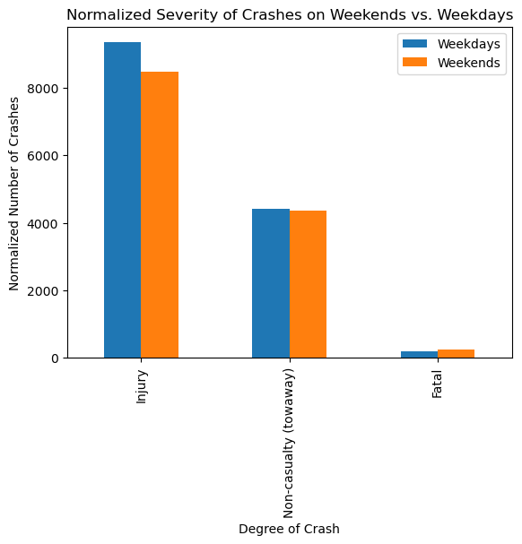
Also apportioned, it shows the severity of crashes are relatively unchanged.

Slide 12
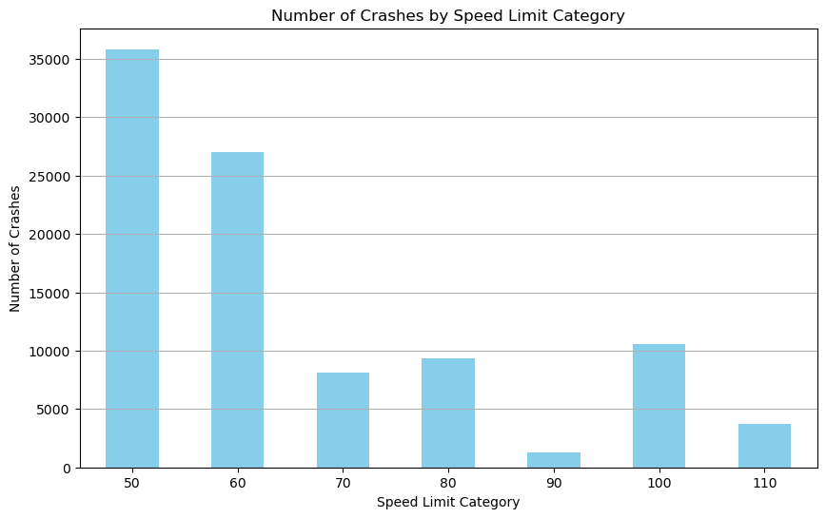
As expected there are more accidents in the lower speed limits as they are far more common.

Slide 13
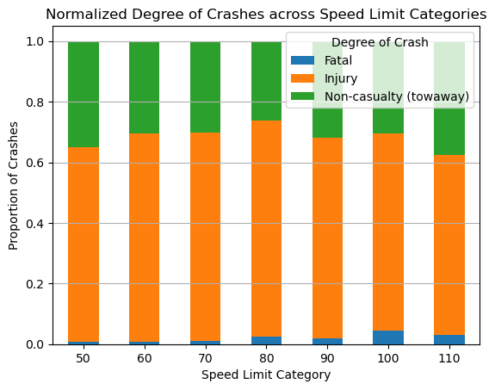
As expected the odds of fatality rise significantly in the upper speed limit categories.

Slide 14
Thank you.

